Slide 1
WHAT IS STATISTICS?
The goal of statistics is to make best guesses or draw conclusions from available data.
Types of Statistics?
✔ Descriptive Statistics - It is used to organize, summarize and describe data for meaningful
insights and data driven decision making
✔ Inferential Statistics - It is used to estimate a property or characteristic of a population based on a sample
✔ Predictive Statistics - It used to predict the future by analyzing historical data
✔ Prescriptive Statistics - If you have multiple solutions, which one is the best solution?

Slide 2
Null and Alternate Hypothesis
The hypothesis to be tested is called the null hypothesis and given the symbol H0.
The null hypothesis states that there is no difference between a hypothesized population mean and a sample mean. It is the status quo hypothesis. For example, if we were to test the hypothesis that employees work 70 hours per week, Can you tell what would be the null hypothesis?
We test the null hypothesis against an alternative hypothesis, which is given the symbol Ha. The alternative hypothesis is often the hypothesis that you believe yourself!
It includes the outcomes not covered by the null hypothesis. In this example, our alternative hypothesis would express that employees do not work for 70 hours in a week

Slide 3
Hypothesis Testing
The primary objective of statistics is to test a hypothesis.
A hypothesis is an educated guess about something. A hypothesis should be testable, either by experiment or observation.
For example:
A new medicine that someone thinks might be better
A new way of working that increases productivity
A Fairness cream that can make you fair or not
Hypothesis testing in statistics is a way for you to test the results of a survey or experiment to see if you have meaningful results. You’re basically testing whether your results are valid by figuring out the odds that your results have happened by chance. If your results may have happened by chance, the experiment won’t be repeatable and so you can’t conclude if it is true.

Slide 4
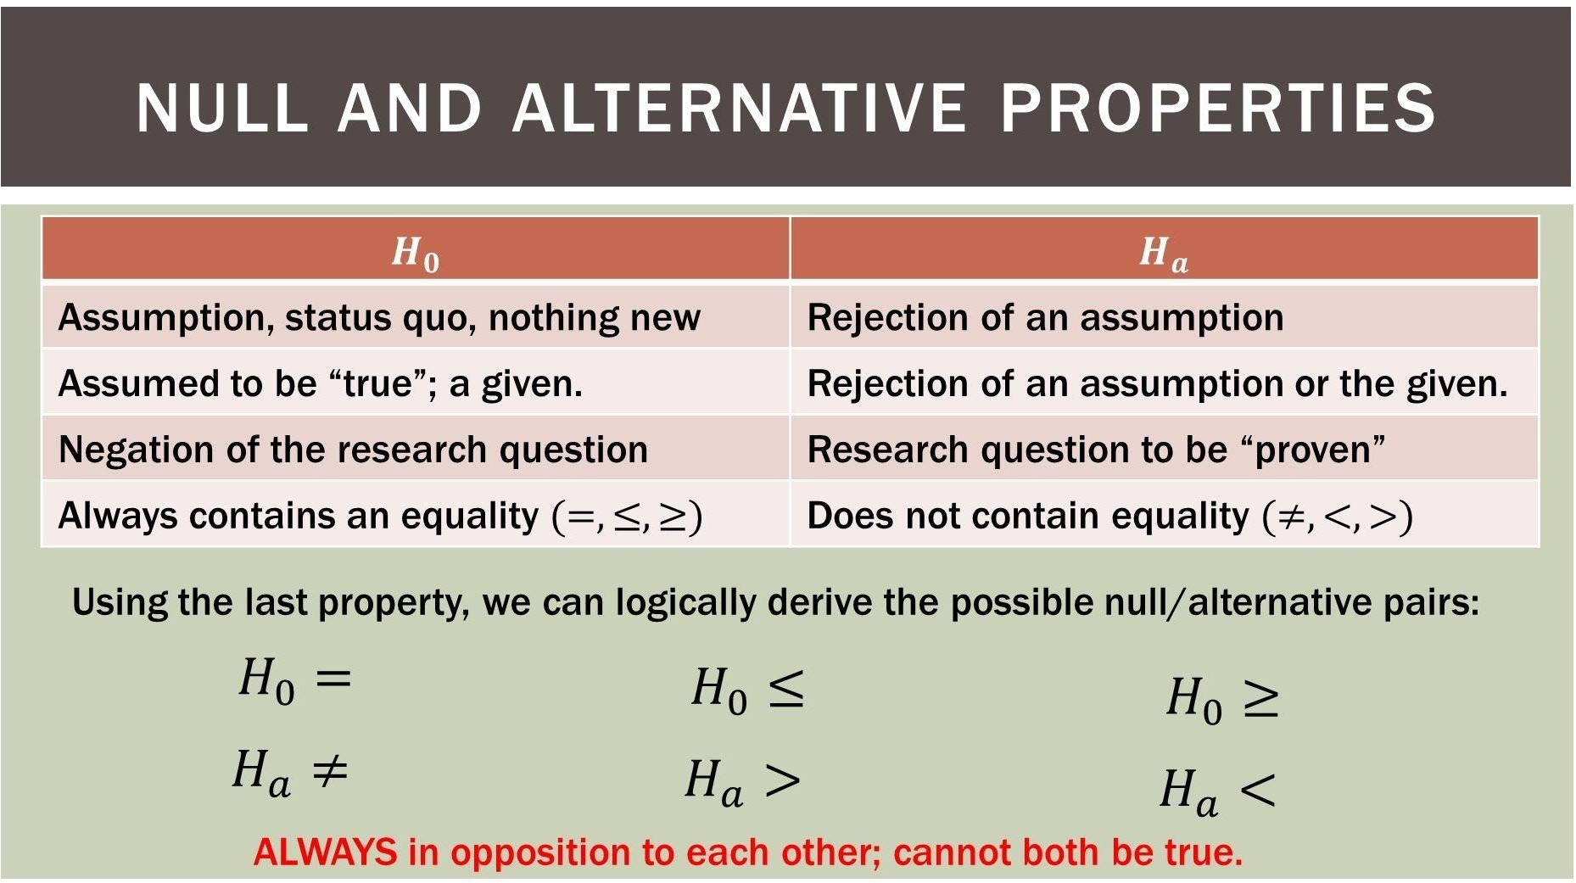
Null and Alternate Hypothesis

Slide 5
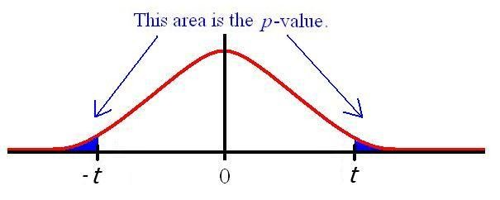
Converting Business Hypothesis to Statistical Test
Understanding Diagnosis Hypothesis Evaluation Prototype Output
Hypothesis enables further analysis process and root causes of investigation.
E.g. (Business problem examples)
Most Customers in my target segment are in the age group of 31- 50
30% of patients tested for cancer are detected to be positive.
Task: What is the Null/alternate hypothesis for above examples?
Null vs. Alternate Hypothesis (Loan default example)
Tip: Best way to identify null/ alternate (Status Quo vs. challenging statement) p- value: Level of Signiﬁcance Accept / reject null using critical regions

Slide 6
Central Limit Theorem
Infer population behaviour using sample data
Sample mean (µ)
Sample Standard error (sigma/ √n) where n = count of observations
Conﬁdence interval (Range for margin of error)
Chosen level of signiﬁcance
Z-score as per signiﬁcance level represents acceptable levels of deviation from mean
Prediction using the Conﬁdence intervals:
Wider range ensures higher tolerance, but precision is lowered.
95% conﬁdence is preferred in most business cases. Business example:
Estimation of expected consumers for new products as per survey
Expected inventory planning using tolerance levels.

